Slide 1


Data Science
Final Project Presentation
Class: IBM IMVAI-1901
Team: 3
Team Members: Justin
Diana Koh, Leong Sunyoi,
Raymond Ang, Vincent Chun

Slide 2
Agenda
Diana Koh
Introduction
Planning Analytics
Leong Sunyoi
Descriptive Analytics
Diagnostic Analytics
Raymond Ang
Predictive Analytics
Vincent Chun
Prescriptive Analytics
Summary and Reflection

Slide 3
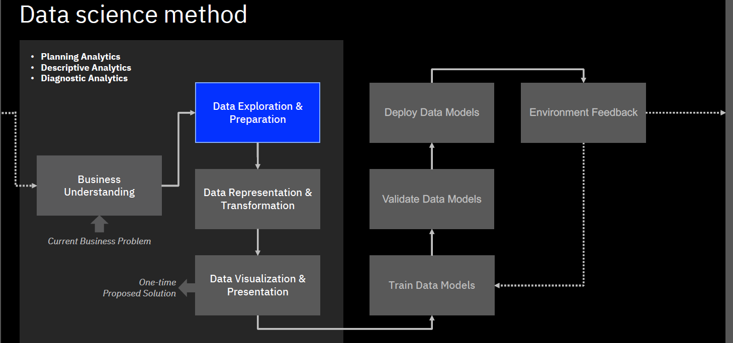
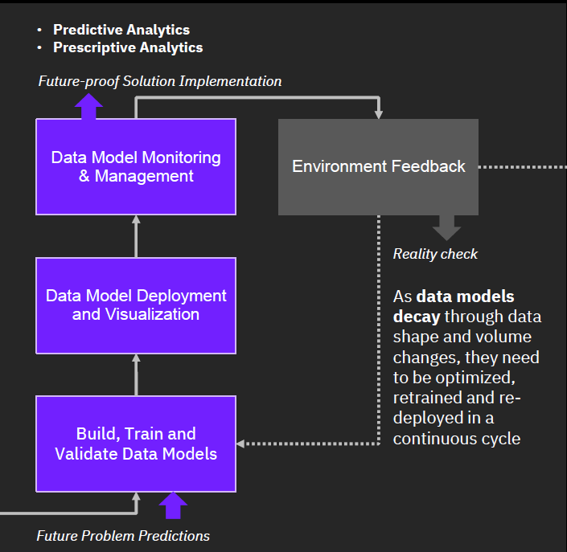
Data Science Method

Slide 4
Project Topic
According to World Health Organization (WHO), stroke is the second leading cause of death and the third leading cause of disability globally.
Stroke is the sudden death of some brain cells due to lack of oxygen when the blood flow to the brain is lost by blockage or rupture of an artery to the brain, it is also a leading cause of dementia and depression.

Slide 5
Introduction
Project Objectives
Personal – medical professionals
How might we use patients' records to assist medical professionals in predicting the probability of a patient suffering a stroke for a proof of concept.
Tools
Mural – for collaboration and Enterprise Design Thinking process
IBM Watson Studio – for data analytics
Data Refinery
Data Visualization
Auto AI
Machine Learning
Cloud Object Storage
Jupyter Notebook
Python
Libraries: Pandas Seaborn Matplotlib Numpy

Slide 6
Team Roles
Team Lead: Vincent Chun
(Sr Scientist/Sr Analyst/ Chief Engineer)
Data Analyst: Diana Koh
Data Engineer: Leong Sunyoi
Data Scientist: Raymond Ang
Extract Data
Prepare Data
Build models
Train Models
Evaluate
Deploy

Slide 7
Planning Analytics

Slide 8
Business Understanding - Problem & Opportunity
Monitoring vital signs like blood pressure and blood glucose can be an effective way to help prevent a stroke.
It provides patients with the assurance they need to feel confident in pursuing lifestyle changes.
Hypertension and diabetes are major risk factors for stroke.
Fortunately, both of them can be effectively minimized by eating healthier, avoiding stress, and exercising more.
In fact, about 80% of strokes are preventable.
Our model is designed to predict the probability of a patient from age 30 onwards, having stroke based on their health indicators.
With sufficient medical care, strokes can be prevented from happening and thereby reducing healthcare costs for caring of stroke patients.

Slide 9
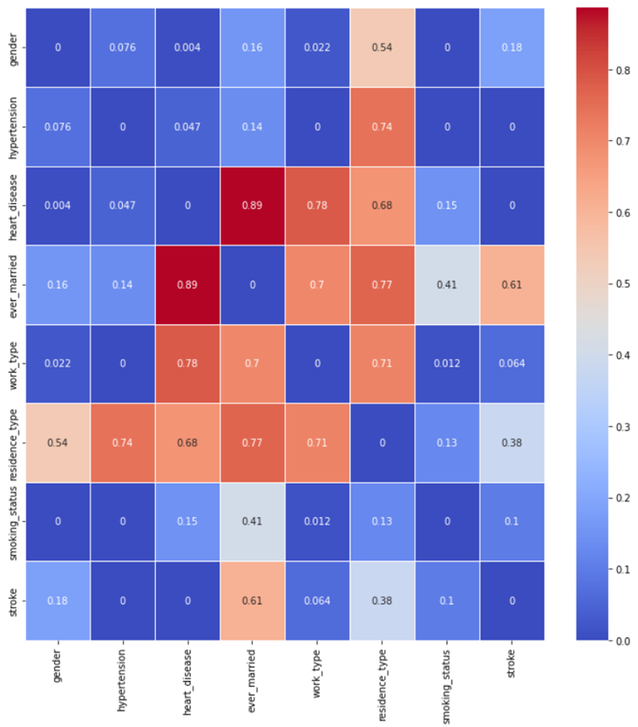
Hypothesis for our model
Stroke is plot based on other categorical variables. The darker the plot, the stronger the correlation.
Therefore, the following factors are deduced from the heat map that affect stroke predictions –
Heart disease
Hypertension

Slide 10
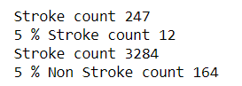
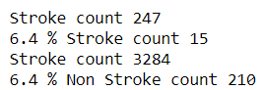
Hypothesis
Stroke is plot based on other variables.
The darker the plot, the stronger the relationship.
Therefore, the following factors are deduced from the heat map that affect stroke predictions –
1. age
2. heart disease
3. hypertension
Phik (φk) is a new and practical correlation coefficient that works consistently between categorical, ordinal and interval variables, captures non-linear dependency and reverts to the Pearson correlation coefficient in case of a bivariate normal input distribution. There is extensive documentation available here.

Slide 11
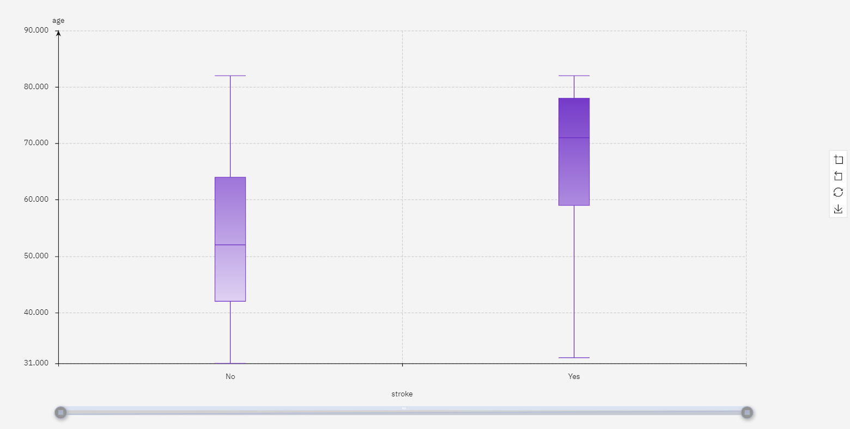
Hypothesis for our model
The risk of stroke increases with age.

Slide 12
Pain Points
Medical professional might overlook giving more attention to patients who are at higher risk of stroke.
Patient's lack of concern by their current lifestyle resulting to a lack of awareness about their probability on getting stroke based on their current habits.
Patients not supporting / believing the medical professional sufficiently in their work to minimize stroke probability.

Slide 13
HMW Statement
How might we use patients' records to assist medical professionals in predicting the probability of a patient suffering a stroke?

Slide 14
Descriptive Analytics

Slide 15
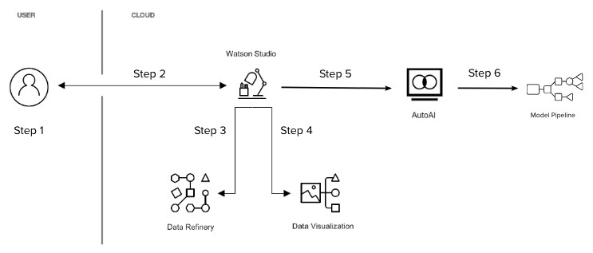
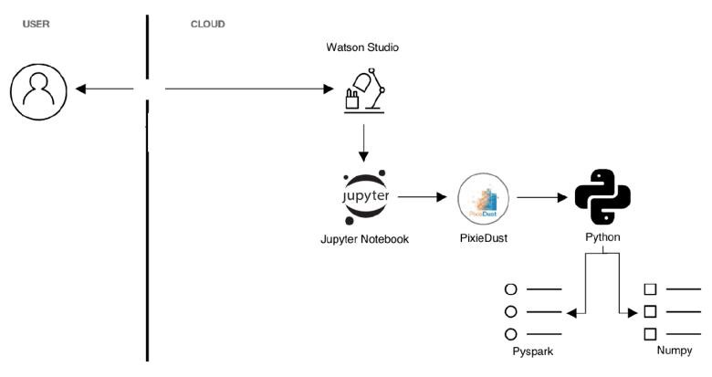
Approach(Sample)
For this project, we will make full use of the functionalities of IBM Watson Studio to perform the data science methodologies. IBM Watson Studio empowers data scientists to scale analysis, collaboration and quick delivery and does not require coding.
Implementation Architecture
Steps outline
Gather the appropriate data set and prepare for analysis.
Import data using IBM Watson Studio service.
Cleanse, analyze and reshape the data using IBM Watson's Data Refinery tool. From the data Profile, we can determine which attributes are relevant.
Visualize preliminary cleansed data results and run
summary statistics.
Create models using IBM Auto AI with Machine Learning service associated. With Auto AI, we can build and deploy a machine learning model with sophisticated training features and no coding.
Determine the best model that can be used to predict customer behavior based on the pipeline results and Deploy.
Note:
Jupyter notebooks was used where detailed analysis or further visualization is required which the automated tool has not produced.
Seaborn
Matplotlib
10

Slide 16
Data Exploration
Data source
The data comes from https://www.kaggle.com/code/rishabh057/healthcare-dataset-stroke-data/data

Slide 17
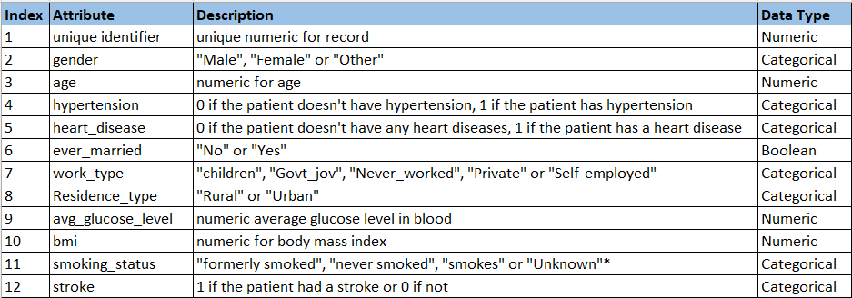
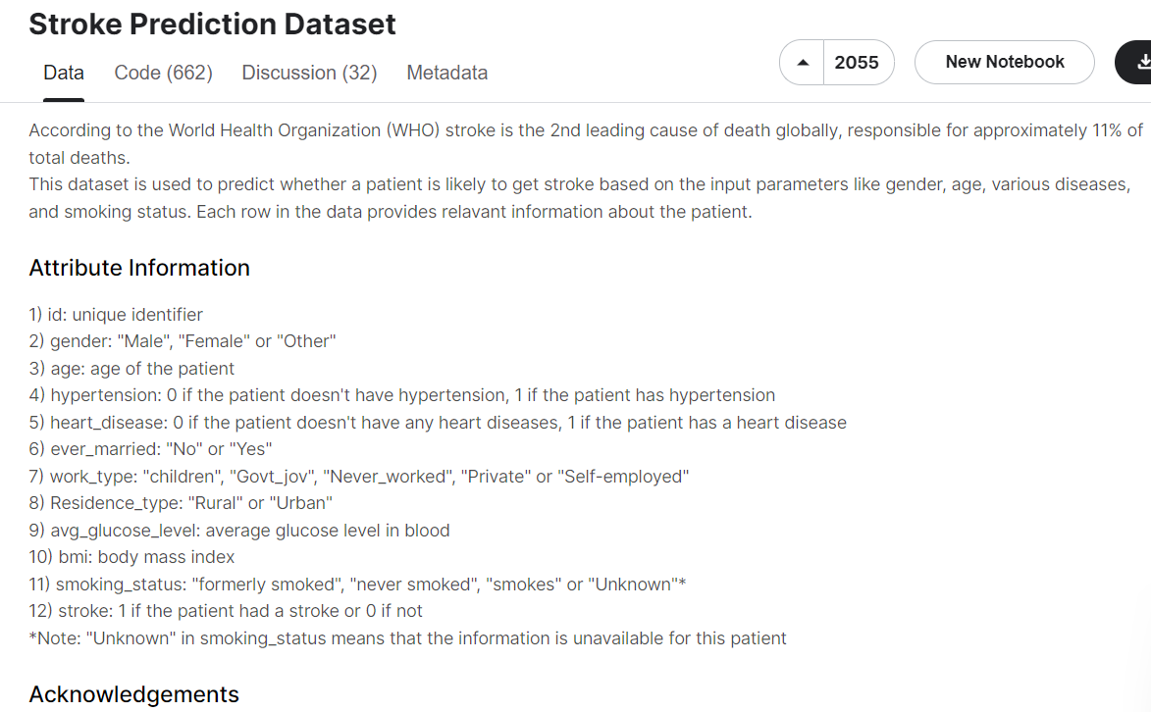
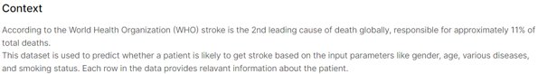
Data Dictionary
Observation
4 Numeric
7 Categorical
1 Boolean

Slide 18
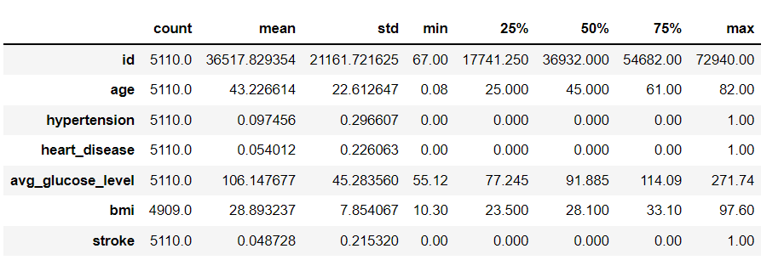
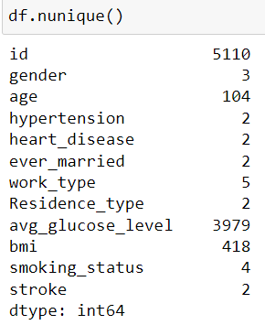
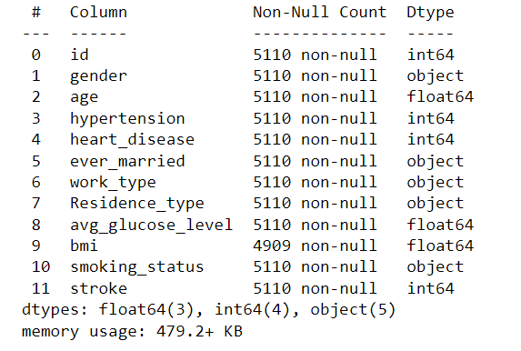
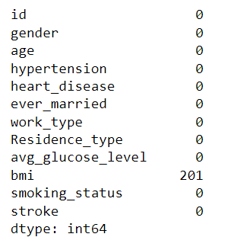
Data Exploration
Statistics of numerical features
Remove id
Hypertension, heart_disease & stroke is
numerical
value, need to convert to Boolean
Feature categories
Information of Dataset
Missing Values
Action: - to replace the missing value with Median of the BMI

Slide 19
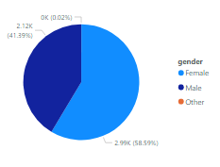
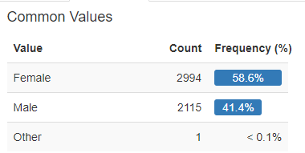
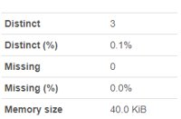
Data Exploration
gender
Observations – ​
Female is higher than male
1 count under other
To remove this 1 count
Notes:
Total 5510 rows
More females than males
Since there is no gender as ‘Other’, to remove from the dataset. Ensure only 2 distinct gender

Slide 20
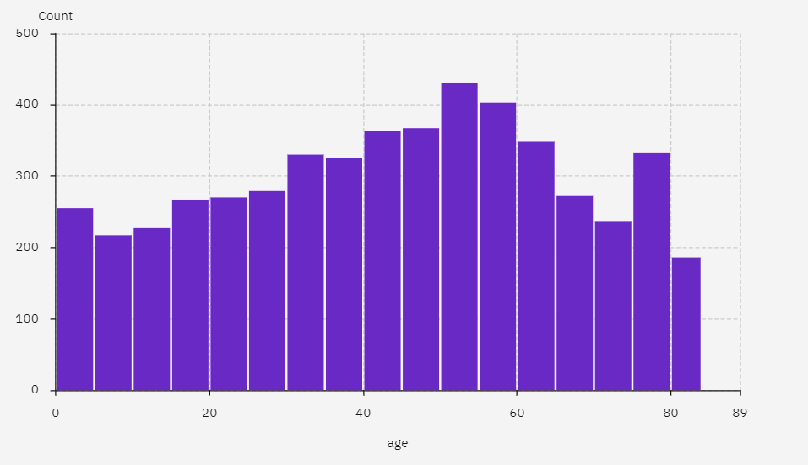
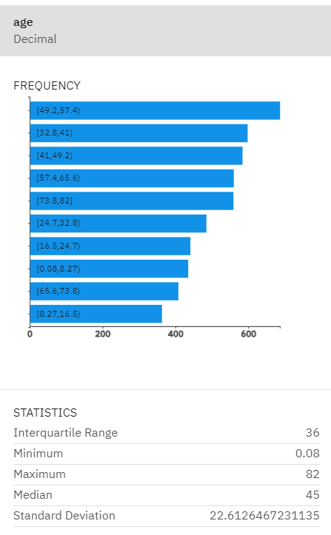
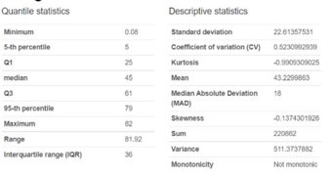
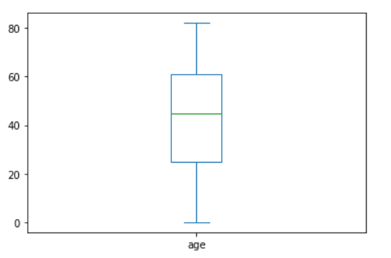
Data Exploration
A distribution of ages from 1 month up to 82 years old.
age
Highlights
- minimum is < I year old
- median age is 45
- Mean age is 43.2
- maximum is 82

Slide 21
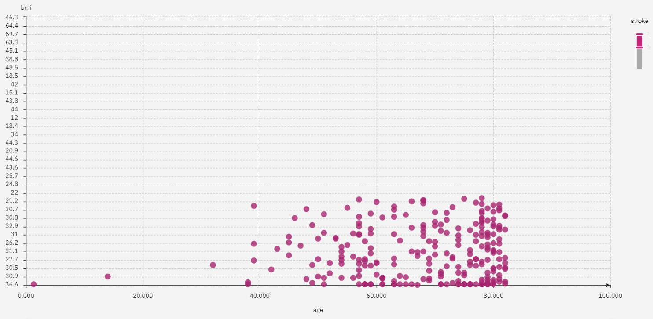
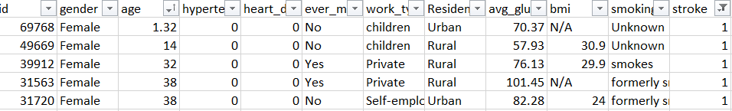
Data Exploration
age
Plot of age with stroke and no stroke
Row Labels | Counts of Stroke | Count of Stroke2
0 – No stroke | 1568 | 99.87%
1 - Stroke | 2 | 0.13%
Grand Total | 1570
Our Findings
1] age 30 and below (1570 counts) only 2 patients has stroke
2] 1570 accounts for 30.7% of the dataset
3] the 2 stroke patient is only 0.13% and 99.7% are no stroke

Slide 22
Data Exploration
age
Actions –
To remove patients who are less than or equal to 30 years old from our dataset (since we have an unbalanced problem, the majority negative class is removed)
To have the model designed to predict for those above 30 years old only.

Slide 23
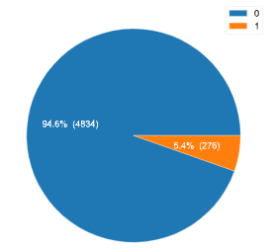
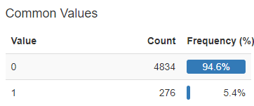
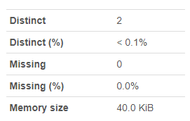
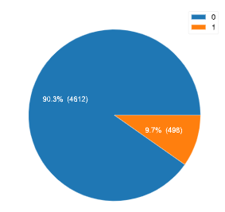
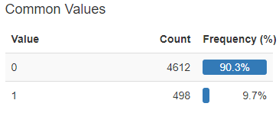
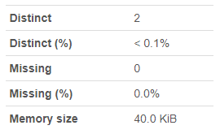
Data Exploration
heart_disease
hypertension

Slide 24
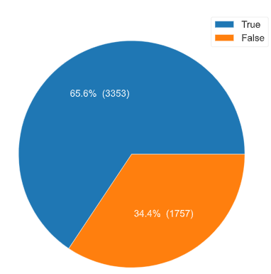
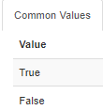
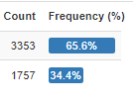
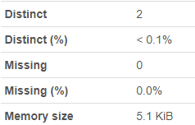
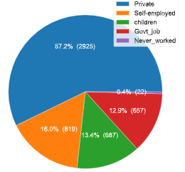
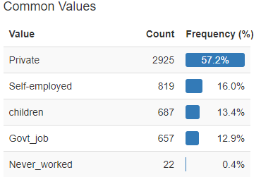
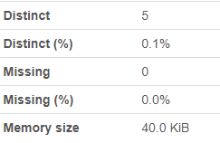
Data Exploration
ever_married
Observations:
Almost 2/3 married
Work_type
Observations:
Private is largest almost 60%

Slide 25
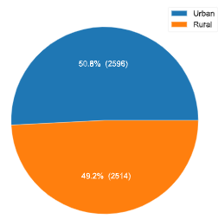
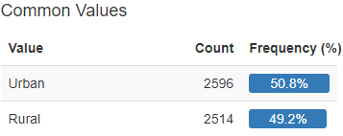
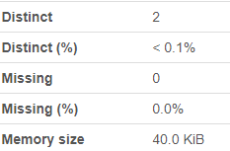
Data Exploration
residence_type
Observations:
Generally balanced with urban slightly more

Slide 26
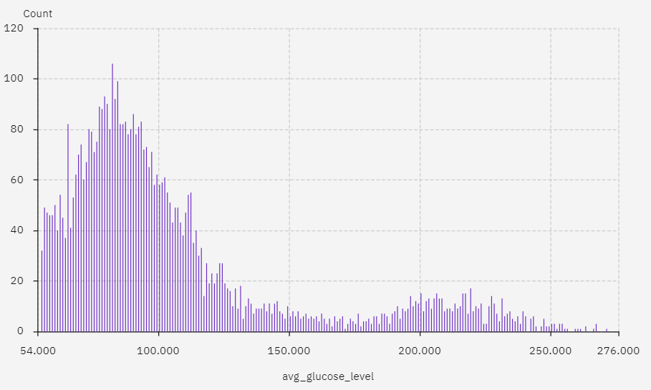
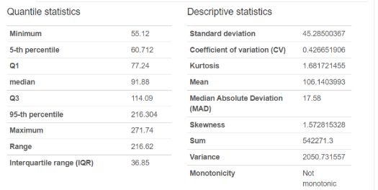

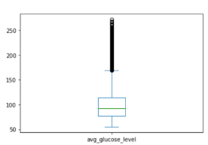
Data Exploration
ave_glucose
Range of ave_glucose is from 55.12 to 271.74.
Median – 91.86
Mean - 106.14
Observations –
Boxplot shown readings above 216 is at 95 percentile is
considered as outlier
216

Slide 27
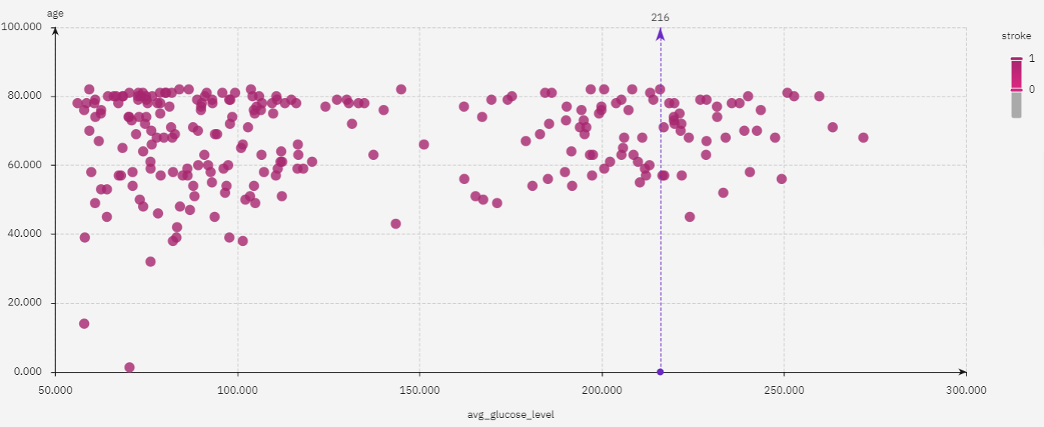
Data Exploration
ave_glucose
Observations –
Further analyze from the scatterplot graph, many strokes incidences (36 counts) were recorded for patients with ave_glucose in the outlier ranges (above 216). These 36 counts account for 14.4% of stroke patient. High glucose reading is an indication of stroke. Team consensus agreed to keep glucose reading unadjusted
Actions –
No action is required.

Slide 28
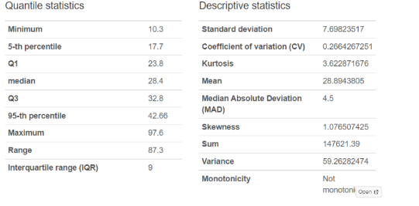
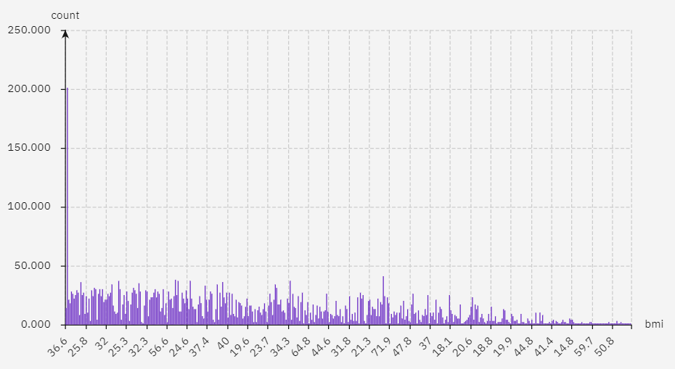
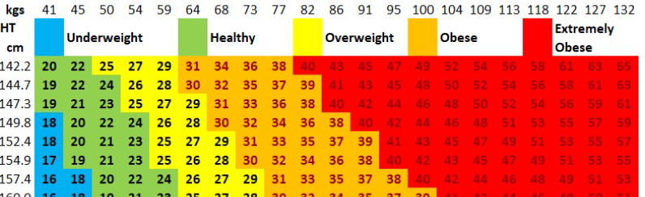
Data Exploration
BMI
Range of BMI is from 10.3 to 97.6
Median – 28.4
Mean - 28.9
There are 201 count label as N/A
From the chart, value
above 60 is for extremely short and obese. We capped
our bmi data at 60

Slide 29
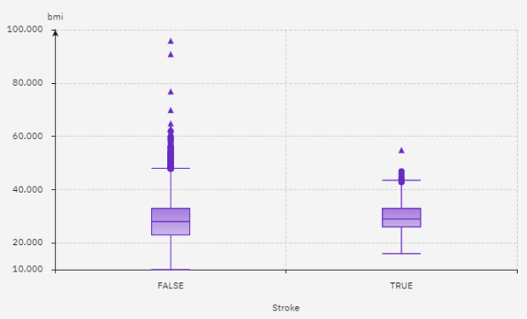
Data Exploration
BMI
Boxplot show the outlier
bmi above 60
Observation – ​
BMI above 60 has 13 counts and they belong to the no stroke class

Slide 30
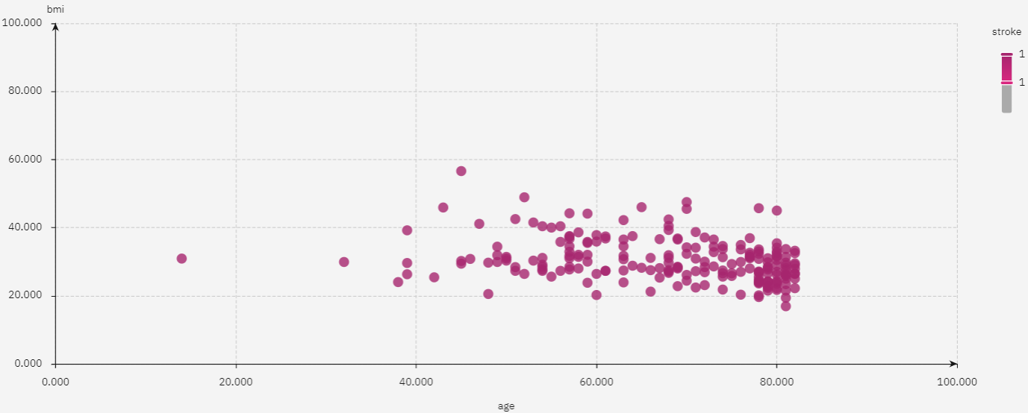
Data Exploration
BMI
Observations –
All strokes has bmi less than 60
Actions –
Replace missing data with median value
Remove records with BMI above 60

Slide 31
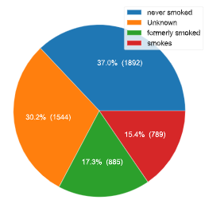






Data Exploration
smoking_status
Observations:
Never smoked is 1/3
Unknown is 1/3
stroke
Observations:
4861 non stroke vs 249 stroke
Ratio 19.5 : 1
High Imbalanced Dataset
Notes:
An imbalanced datasets is one where the labels aren't distributed similarly, that is, you have many more of one label than others. In these situations, the trained classifier often becomes biased towards the majority label class and tends to miss the minority class. This will be an issue in cases where we want to detect that minority class, say in fraud detection, or early detection of cancer cells.

Slide 32
Data Exploration
Data understanding summary
The data contains 5110 observations with 12 attributes.
The feature id served as a unique identifier of a patient. We’ll drop it from the dataset because it is not relevant in predicting the probability of a stroke.
Remove the one record with value ‘Other’ in the gender column.
There are missing data (201 rows) in BMI column; replace them with median
There are three numerical attributes: 'age‘, 'avg_glucose_level‘, 'bmi‘. The rest are categorical attributes.
There are outliers – bmi and age.
We have an imbalanced class problem.

Slide 33



Data Representation and Transformation
Data Transformation
gender (other) to be removed (1 count)
age below 30 to be removed ( 1570 count)
BMI N/A is replaced with median (29.7)
BMI above 60 to be removed ( 4 count)
id feature to be removed
For hypertension, heart_disease and stroke, we replaced "0" with "No" and "1" with "Yes"
Information of Dataset
Feature categories
 | From | To
Rows count | 5110 | 3291
Ratio of stroke vs non stroke | 19.5 : 1 | 14 : 1
* 6.8 % of the dataset (240 rows) is set aside for testing

Slide 34
Selecting data sample for testing
The following factors are deduced from the heat map that affect stroke predictions –
1. age, 2. heart disease, 3. ave_glucose level & 4. hypertension
heart disease and hypertension are categorical data
We have selected 6.8 % from both Majority and Minority data.
Our Training and test dataset is now 3291 rows
Total Count | 3531 |  | Male | 1432
 |  |  | Female | 2099
 |  | 5% of total sampling population |  | Fix 2- heart dis & hypertension- Yes | Fix 1- heart dis - Yes
Stroke | No | 164 |  | 51 | 227
Stroke | Yes | 12 |  | 13
 |  | 177 |  | 64 | 240
 |  |  |  | 1.8% | 6.8%

Slide 35





Data Visualisation
gender
Ratio of Female vs Male is 3:2
age
Range from 31 to 82
Mean is 55
High count at age 31

Slide 36






Data Visualisation
Heart_disease
hypertension

Slide 37






Data Visualisation
ever_married
Majority are married
Work_type
Reduce from 5 to 3 category,
remove children & never_worked

Slide 38





Data Visualisation
residence_type
Balanced split between Urban and Rural
average_glucose
Distribution is positively skewed

Slide 39



Data Visualisation
BMI
High frequency count for bmi 25 to 30 account for 37% of dataset
Mean is 30.7

Slide 40
Diagnostic Analytics

Slide 41

Attribute Insights
Using Statistical Inference to find correlation between:
a continuous and continuous variable (Pearson)
a categorical and categorical variable (Chi-Square)
a continuous and categorical variable (Boxplot)
Darker shade of tone has a lower correlation while a lighter shade of tone is linearly correlated.
Chart updated 25 Apr@1044
20

Slide 42
Attribute Insights
Using Statistical Inference to find correlation between:
a continuous and continuous variable (Pearson)
a categorical and categorical variable (Chi-Square)
a continuous and categorical variable (Boxplot)
20

Slide 43
Attribute Insights
Parametric Correlation Analysis
A method to find correlation between linearly related continuous numerical variables
Example is Pearson correlation
Asumptions:
The data are normally distributed
The data are continuous numerical variables
The variables are linearly related
20

Slide 44



Attribute Insight - Pairplot
•Three continuous numerical variables out of 11 features
- Normally distributed?
•bmi – yes
•avg_glucose_level – +ve skewed
•age – evenly distributed
- No correlation observed

Slide 45

Attribute Insight - Use Seaborn to visualize the Pearson correlation coefficient
•A Pearson correlation coefficient value greater than 0.7 indicates the presence of multi-collinearity
•There are no correlation observed

Slide 46
Attribute Insights
Non Parametric Correlation Analysis
Measure the strength of the direction of the association exists between two variables.
A method to find correlation between categorical, nonlinearly related, non-normally distributed variables
Example of techniques are
Spearman's rank Correlation (ordinal data type)
Chi Square correlation
20

Slide 47


Slide 48

Continuous
Discrete

Slide 49
•Chi-square test of independence
•Coded in Python to create this heatmap
•Display p value
•α = 0.05
Our null hypothesis is that variables are independent.
Objective is to find correlation between variables and we reject the null hypothesis, ie p < 0.05
Summary
heart_disease gender & hypertension
work_type gender & hypertension
smoking_status gender, hypertension
& work_type
stroke hypertension & heart_disease

Slide 50

Attribute Insight
Qns : Does Stroke happen to higher age patient ?
Line of central tendency
Line of central tendency
Stroke does increase in age

Slide 51

Attribute Insight
Qns : Does stroke patient has higher glucose level ?
Line of central tendency
Line of central tendency
Stroke does not show a correlation with avg_glucose_level

Slide 52

Attribute Insight
Qns : Does stroke patient has a higher bmi reading ?
Line of central tendency
Line of central tendency
Stroke does not show a correlation with bmi

Slide 53


Need to use the training dataset
Data Exploration
Data understanding the raw data (Leong)
BMI vs Glucose level has a higher correlation
Age vs BMI has small correlation as the
gradient of the line is not change little.

Slide 54

Data Preparation(Cleansing)
1. Removal of ID column
2. Removal of option "other" in the gender column
3. age – filter to show only values more than 30 years old
4. bmi –
Removal of outlier BMI records above 60 (safe to remove as they belong to no stroke class)
Replace 167 missing occurrences with median bmi of 29.7.

Slide 55
Data Representation and Transformation
Python – slide 31
Normalization
One hot encoding
Categorical data

Slide 56


Data Visualization(Sample)
Average Page Value by Month
PageValue seems to have increased over the months, except for a fall in June and July. Higher page values correspond with higher revenue. A page with high value can be viewed as an important page any visitor should see as it helps to convert.
VisitorType & Exit Rates vs Revenue
There are fewer purchases are made on weekends. Returning visitors have higher exit rates without making purchase. New visitors have lower exit rates compared with returning visitors. Visitor type 'Other' category also has a high exit rate in the weekend.

Slide 57
Data Visualization

Slide 58
Raymond to add chart
Visualizations to prove hypothesis before training.
Monitoring vital signs like blood pressure and blood glucose can be an effective way to help prevent a stroke.
It provides patients with the assurance they need to feel confident in pursuing lifestyle changes.
Hypertension and diabetes are major risk factors for stroke.
Does smoking increases the risk of young people (AGE 30 to 40) having stroke.
Heart disease may have a correlation with stroke
Glucose may have a correlation with stroke
Age vs Glucose level may have relationship
Stroke risk increases with Age
Overweight and obesity:=> Woman BMI vs stroke | Man BMI vs stroke

Slide 59


Attribute Insights（Sample）
Month
There is a significant increase in Revenue for the month of November and slight increase in March, May and December. This suggests that seasonal promotions for these months are proving effective, however, as the dataset does not have data for month of Jan and April we have incomplete information to arrive at a definitive conclusion.
20

Slide 60


Attribute Insights
Qns: Does smoking increases the risk of young and old people having stroke.
Plot show smoking or formerly smoke does not increase the number of people who is having stroke for young and old people

Slide 61


Attribute Insights
Split By Stroke and No Stroke
Stroke risk increases with Age
Generally the presence of stroke increases with age
Females show presence of stroke at younger age (30s) than males (40s)
More females show presence of stroke than males at older age (65 above)
No Male has stroke at age below 40
No Stroke
Stroke
Male – 102
Female - 132
Age 65 & below
Stroke increase with age
Male – 60
Female - 84

Slide 62

Attribute Insights
Overweight and obesity:=> Male BMI vs stroke | Female BMI vs stroke
Males’ BMI between 25 to 35 show more stroke present especially for older age (70 above)
Females’ BMI between 30 to 42 show more stroke present especially for older age (65 above)

Slide 63

Attribute Insights - BMI vs Stroke
Overweight and obesity:=> Male BMI vs stroke | Female BMI vs stroke
Males’ BMI between 25 to 35 show more stroke present especially for older age (70 above)
Females’ BMI between 30 to 42 show more stroke present especially for older age (65 above)

Slide 64

Attribute Insights
population show more presence of stroke in older age with average glucose level
population show more presence of stroke in older age and higher bmi

Slide 65






Attribute Insights
Self-employed shows highest presence of stroke 8.8% comparing Govt_job and Private
Male gender shows self-employed has the highest presence of stroke 10.2% comparing Govt_job and Private
Males
Female gender shows self-employed has the highest presence of stroke 8.18.2% comparing Govt_job and Private
Females

Slide 66
Predictive Analytics

Slide 67
Predictive Analytics – Training of the model
3 models trained
(A) Totally Imbalance – Auto AI with dataset 3,000:250
(B) Balance dataset – Auto AI through under sampling with dataset 250:250
(C) Smote – with Auto AI with dataset 3,000:3,000
Settings of the training
(I) Recall optimised
(II) Algoritum used – 2/4
(II) Selected Decision tree classifier, Extra tree classfier, LGBM Classifier, Logistic Regression, Random Forest Classifer & XGB Classifier
(III) Deselected SNAP

Slide 68



Configuration of experiment settings for Totally Imbalanced Dataset
Experiment:
Original datasets
Balanced (under sample)
SMOTE(over sample)
Configurations
Target: Stroke
Prediction: Binary Classification
Positive Class: Yes
Optimized: Recall
Data split: 90% (Train) & 10% (Test)
Features selected: all exclude Stroke
8 pipelines for each dataset
Auto AI auto generated with various algorithms

Slide 69


Totally Imbalanced Dataset – Pipeline 7
Totally imbalanced
We fed the data into IBM's Auto AI using Stroke as the prediction column to predict if a patient will be down with Stroke.
Amongst all the 8 pipelines generated after running AutoAI, the Pipeline 7 with a Decision Tree Classifier
Classifier algorithm has the highest rank with a model of 76.9%.

Slide 70


Imbalanced Dataset – Confusion matrix
Pipeline 7- Decision Tree Classifier
Pipeline 8 - Decision Tree Classifier

Slide 71


Imbalanced Dataset – Precision recall curve
Pipeline 7 - Decision Tree Classifier
Pipeline 8 - Decision Tree Classifier

Slide 72


Imbalanced Dataset – Model evaluation measure
Pipeline 7 - Decision Tree Classifier
Pipeline 8 - Decision Tree Classifier
Values hidden as accuracy is not a factor for consideration

Slide 73


Imbalanced Dataset – Feature Summary
Pipeline 7 – Decision tree
Pipeline 8 - Decision tree
Both models show the same 3 significant features: Age, heart_disease, square(age)

Slide 74




Balanced Dataset using under sampling
Before | After
3291 | 468
Stroke: *Majority class = No | Minority class = Yes
Challenge:
An imbalanced classification problem is an example of a classification problem where the distribution of examples across the known classes is biased or skewed
Imbalanced classifications pose a challenge for predictive modeling as most of the machine learning algorithms used for classification were designed around the assumption of an equal number of examples for each class. This results in models that have poor predictive performance, specifically for the minority class. This is a problem because typically, the minority class is more important and therefore the problem is more sensitive to classification errors for the minority class than the majority class
Imbalanced
Balanced
13:1
1:1
Notes:
Imbalanced datasets are those where there is a severe skew in the class distribution, such as 1:13 herein the minority class to the majority class.

Slide 75










Training data
Undersampling by Python
AutoAI
Balanced – Undersampling
We fed the data into IBM's Auto AI using STROKE as the prediction column to predict if one is having stroke . Amongst all the 8 pipelines generated after running AutoAI, the Pipeline 2 with Gradient Boosting Classifier algorithm has the highest rank with a model of 80% Precision.
Comparing with other top ranked pipelines based on Recall and F1 score, we decided to explore two models:
For highest Recall is Pipeline 2 - Gradient Boosting Classifier
For 2nd highest F1 is Pipeline 1* - Gradient Boosting Classifier (*since the highest F1 is Pipeline 2)
After looking through the other top ranked pipelines based on Recall and F1 score, we decided to use the model based on the highest Recall followed by F1 and Pipeline 2 is the best model on the balanced datasets using undersampling in majority class

Slide 76


Training data
Undersampling by Python
AutoAI
Undersampling – Confusion matrix
Pipeline 2 - Gradient Boosting Classifier
Pipeline 1 - Gradient Boosting Classifier

Slide 77


Training data
AutoAI
Undersampling by Python
Undersampling – Precision Recall Curve
Pipeline 2 - Gradient Boosting Classifier
Pipeline 1 - Gradient Boosting Classifier

Slide 78


Training data
AutoAI
Undersampling by Python
Undersampling – Model evaluation measure
Pipeline 2 - Decision Tree Classifier
Pipeline 1 - Gradient Boosting Classifier
Values hidden as accuracy is not a factor for consideration

Slide 79


Training data
AutoAI
Undersampling by Python
Undersampling – Feature Summary
Pipeline 2 - Gradient Boosting Classifier
Pipeline 1 - Gradient Boosting Classifier
Both pipelines show 3 features of high correlation: age, bmi, avg_glucose_level

Slide 80


SMOTE - Synthetic Minority Oversampling Technique
It is an over-sampling technique in which new synthetic observations are created using the existing samples of the minority class.
SMOTE for Imbalanced Dataset (opengenus.org)
(110) SMOTE - Synthetic Minority Oversampling Technique - YouTube

Slide 81



Training data
SMOTE by Python
AutoAI
SMOTE
We fed the data into IBM's Auto AI using STROKE as the prediction column to predict whether a patient would suffer a stroke. Amongst all the 8 pipelines generated after running AutoAI, the Pipeline 1 with a Decision Tree Classifier algorithm has the highest rank with a model of 96.3% Recall.
After looking through the other top ranked pipelines based on Recall and F1 score, we decided to check out two the models:
based on highest Recall, we choose Pipeline 1 - Decision Tree Classifier
based on highest F1 followed by highest Recall, we choose Pipeline 8 - Random Forest Classifier
as we want to err on the safe side for predicting stroke.

Slide 82


Training data
SMOTE by Python
AutoAI
SMOTE – Confusion matrix
Pipeline 1 - Decision Tree Classifier
Pipeline 8 - Random Forest Classifier

Slide 83


Training data
SMOTE by Python
AutoAI
SMOTE – Precision Recall Curve
Pipeline 1 - Decision Tree Classifier
Pipeline 8 - Random Forest Classifier

Slide 84


Training data
SMOTE by Python
AutoAI
SMOTE – Model evaluation measure
Pipeline 1 - Decision Tree Classifier
Pipeline 8 - Random Forest Classifier
Values hidden as accuracy is not a factor for consideration

Slide 85


Training data
SMOTE by Python
AutoAI
SMOTE – Feature Summary
Pipeline 1 - Decision Tree Classifier
Pipeline 8 - Random Forest Classifier

Slide 86


SMOTE – Testing on unseen data
Pipeline 1 - Decision Tree Classifier
Based on unseen dataset, the result is less than desired. Therefore, more data is required for higher accuracy of model training.
Precision and accuracy are lacking.
Pipeline 8 - Random Forest Classifier

Slide 87




Validate Data Models(Sample)
From Pipeline1, we can see that the model accuracy is 90%, precision is 70% and recall is 50%. Looking at the ROC curve, we can see it is 0.9 which is near 1 which means it has a good measure of separability to distinguish between negative and positive classes.
The F1 measure or score is a test of measure of a test's accuracy. It is calculated from the precision and recall of the test. As our F1 measure is 0.6, it has quite a high precision and recall for our objective to predict sales. An F1 score of 1 would have perfect precision and recall.
Precision and Recall is influenced by the proportion of True vs False Revenues in the data set where we get a higher number of customer's browsing on the website that is not translating to confirmed orders.
As our goal is to increase the number of sales with the prediction model and corresponding recommendations of site improvements, we should see these numbers improve over time as new data is fed and the model is re-trained.
24

Slide 88
Prescriptive Analytics

Slide 89

Model Deployment
Original data
Prior to model building -
We have set aside 5% counts of stroke patients and non stroke patients for testing.
Test set data
Stroke – 249
Non stroke – 4861
Stroke – 25
Non Stroke – 486

Slide 90
Models Comparison based on Holdout Score
 | Recall | F1 | Precision | Log Loss | Rank
Original imbalanced | 100% | 10.35% | 5.4% | 32.669 | 3
Balanced using under sampling | 77.1% | 76.1% | 75.0% | 0.549 | 2
Balanced using SMOTE​ oversampling | 96.1% | 96.6% | 97.1% | 0.167 | 1

Slide 91
SMOTE – Testing on unseen data
Based on unseen test dataset, the result differs with the model's expected score (suspect overfitting).
Therefore, more experiments and data is required for the model training.
Precision and accuracy are lacking.
Pipeline 1 - Decision Tree Classifier
Pipeline 8 - Random Forest Classifier

Slide 92
Recommended Best for Model Deployment
We have used the following model deployment - ​
1. Recall testing – ​
If 2 models have the same recall results, we will proceed to use precision testing. ​
​
2. Precision testing​
Precision recall curve​
​
3. Why we do not use Accuracy testing​
Accuracy = Number of correct predictions / Number of all predictions

Slide 93


Slide 94
Environment Feedback(Reality Check)
After deployment checks.

Slide 95
Summary & Reflection

Slide 96
Constraints and Challenges
Small sample size After cleaning our initial dataset of 5110 patients' records, it is left with about 3284 negative or majority class and 247 positive or minority class.
Dataset is severely imbalanced; it is in the ratio of 13 : 1 a. Best solution – search for more data to bring up the minority class b. Undersampling the majority class c. Oversampling the minority class – SMOTE
Limited features of 11 We will seek advice from the subject matter expert, our medical team, for useful features
IBM runtime usage is limited to 10 CUH and not able to create trial account, we're unable to further explore AutoAI with more experiments.
30

Slide 97
Constraints and Challenges
Challenges
Imbalanced dataset
Methods for choice of data set for sampling and training
Confusion matrix – testing data greater than training model data
https://machinelearningmastery.com/precision-recall-and-f-measure-for-imbalanced-classification/#:~:text=Precision%20vs.-,Recall%20for%20Imbalanced%20Classification,the%20number%20of%20false%20negatives
30

Slide 98
Constraints and Challenges
Challenges
Imbalance Dataset
We explore under sampling and over sampling. The result is not good.
We further explore applying SMOTE, the result has some improvement but …......
Next, we search for more dataset and bring up the minority to the ratio of 4.2 : 1
https://neptune.ai/blog/how-to-deal-with-imbalanced-classification-and-regression-data
https://machinelearningmastery.com/tactics-to-combat-imbalanced-classes-in-your-machine-learning-dataset/
https://towardsdatascience.com/handling-imbalanced-datasets-in-machine-learning-7a0e84220f28
Learning of other skills to have a complete understanding of tools such as Python, Github, Web hosting & etc.
These are some tools that have been showcased during our course. We find that these are very useful and feel limited in our capabilities. For someone who do not used python before, it is a challenge to be able to write the program. Time, resource and motivation are needed to start.
30

Slide 99
Conclusion
Our best model is not meeting the medical industry standards.
The model shows a high recall of 96.1% and a high precision of 97.1%. However, testing it with an unseen test dataset, the precision is falling short at 6%.

Slide 100
Future Enhancement
More data is needed to build and train our model.
More features such as weight, height, body fat %, muscle mass to be collected.
Possible binning the continuous variable, age, BMI (e.g. low, moderate, high), glucose (low, moderate, high).
AutoAI is a useful tool for proof of concept and rapid prototyping; it identifies the significant features and potential algorithms for predicting who might suffer a stroke.

Slide 101
Our Valuable Experience
Interesting to learn the functionalities of IBM Watson Studio and how it can be used in deploying DS solutions without coding and rapidly
Learning to solve a problem and gain actionable insights that drives business value by going through the 5 stages of a data analytics lifecycle: Planning, Descriptive, Diagnostic, Predictive, Prescriptive
Gained appreciation and experienced the work of a Data Team
Learned key strategies to solve an imbalanced class problem which are very common especially in the medical field
The display of the Confusion Matrix in AutoAI is spotted and suspected to be incorrect (Suhaimi will confirm with IBM)
Working through the challenges together as a team and leveraging the strength of each member

Slide 102
Special thanks to:
Suhaimi – Our trainer
Fellow team mates who have spent lots of time and effort in this project; great friendship is established

Slide 103






Friendship takes work and we celebrated our work
27 Apr 2022 @1045-1330

Slide 104
Second dataset

Slide 105


Totally Imbalanced with second dataset
We fed the data into IBM's Auto AI using STROKE as the prediction column to predict whether a patient would suffer a stroke. Amongst all the 8 pipelines generated after running AutoAI, the Pipeline 1 with a Decision Tree Classifier algorithm has the highest rank with a model of 96.3% Recall.
After looking through the other top ranked pipelines based on Recall and F1 score, we decided to check out two the models:
based on highest Recall, we choose Pipeline 1 - Decision Tree Classifier
based on highest F1 followed by highest Recall, we choose Pipeline 8 - Random Forest Classifier
as we want to err on the safe side for predicting stroke.

Slide 106


Feature Summary
Pipeline 8 – Decision Tree Classifier
Pipeline 6 – Decision Tree Classifier
Both models show the same 3 significant features: Age, heart_disease & hypertension

Slide 107


Confusion Matrix
Pipeline 8 - Decision Tree Classifier
Pipeline 6 - Decision Tree Classifier

Slide 108


Pipeline 8 - Decision Tree Classifier
Pipeline 6 - Decision Tree Classifier

Slide 109


Model evaluation measure
Pipeline 8 - Decision Tree Classifier
Pipeline 6 - Decision Tree Classifier

Slide 110


Feature Summery
Pipeline 8 - Decision Tree Classifier
Pipeline 6 - Decision Tree Classifier

Slide 111
Validate Data Models(Sample)
From Pipeline1, we can see that the model accuracy is 90%, precision is 70% and recall is 50%. Looking at the ROC curve, we can see it is 0.9 which is near 1 which means it has a good measure of separability to distinguish between negative and positive classes.
The F1 measure or score is a test of measure of a test's accuracy. It is calculated from the precision and recall of the test. As our F1 measure is 0.6, it has quite a high precision and recall for our objective to predict sales. An F1 score of 1 would have perfect precision and recall.
Precision and Recall is influenced by the proportion of True vs False Revenues in the data set where we get a higher number of customer's browsing on the website that is not translating to confirmed orders.
As our goal is to increase the number of sales with the prediction model and corresponding recommendations of site improvements, we should see these numbers improve over time as new data is fed and the model is re-trained.
24

Slide 112
0421 To Do
Parking – Phyton – slide 31
Normalization
One hot encoding
Categorical data
62 – environment feedback
Get more records
(1) Profiling Report? - Slide 27 [Vincent]
Correlation between:
a continuous and continuous variable
a categorical and categorical variable
a continuous and categorical variable
(2) Slide 60& 61 – regarding model deployment & selection. [Diana] - team support, populate according to the slides that we do based on Vincent's slide example. Compile into slide 60.
(3) 64 & 65 Constrains and challenges [Leong]
(4) 66 & 67 – Conclusion and enhancements (Team efforts)
(5) 34-36 – Diagnostic analytics on our assumptions (ref EDT) [Raymond]

Slide 113


Thank You

Slide 114


Questions for instructor
1. Slide 26 % for deployment testing
Currently it is 10%. Is there a model % (industry standard)? (Train-Valid-Test)
2. Does Auto AI detect any imbalances or do we need to prepare dataset before using Auto AI --> project objective?
3. Can Auto AI handle imbalance datasets to build baseline models? (NO)
4. How does SMOTE treat the data?
5. How to use API for model deployment?
Majority
Minority

Slide 115
Questions for instructor on 25 Apr
1. Suspect IBM has blocked the ability to create new trial account.

Slide 116
0419 To do
Phyton / Auto AI (Data Representation & Transformation)
Normalization
One hot encoding
Categorical data
1. Touch up the slides
2. Data has already been cleansed – to do the auto AI --> 5% to be kept aside to do for Auto AI.
How is the 5% selected – random selection (interaction between all of the features – basis on selection for this random selection. (80% of time required)
Keep aside.
Balance to be run for step 3. (20% of time required)
3. To run (slide 39 onwards)
(A) Totally Imbalance (Auto AI) --> plug and play – training set. E.g 3,000:250 (Diana) + Team lunch party
(B) Balance dataset (Auto AI) - through under sampling --> plug, adjust and play – [250:250] 209:209 (Raymond)
(C) Smote (Auto AI) --> plug, adjust and play (3,000:3,000)
--> 1. deselect SNAP, Performance matrix --> Recall only, score only, decision tree classifier, extra tree classfier, LGBM Classifier, Logistic Regression, Random Forest Classifer, XGB Classifier, Algoritum to use --> 2/4
4. Constrains and challenges of an Imbalanced
Explanation of SMOTE – pls drop the links on PowerPoint 45.
Deployment of Auto AI

Slide 117





Balanced Dataset using under sampling
Before | After
2757* | 209
*Majority class = 0
AutoAI prediction result

Slide 118

Questions for the instructor 0419
How to choose data for test sampling.
Does AutoAI take care of normalization and encoding.

Slide 119
Training Imbalanced dataset
Skewness in data
Findings supported by Articles and referrals – also in slide for challenges
Test model -
Positive and negative outcomes
Model also skewed
Totally Imbalance
Balance Manually
Smote
Down sample / SMOTE
Second training – confusion matrix more balanced
(Reduce majority class '0')

Slide 120




SMOTE – Feature Summary
Raymond: Update for status
Both models show the same 3 significant features: Age, bmi , glucose

Slide 121
0425 To do
1. Update slides 16 onwards pending new graphs by Raymond
2. Summary of the 3 models tested – we use holdout score, slide 71 – Vincent, Diana & Raymond
3. Raymond – slide 44, visualizations to prove insights, update EDA chart, confusion matrix

Slide 122


ETL to get 3K
Leong to input data changed from 5k to 3k
Missing Values

Slide 123
2704 Raymond - 57, 68 Leong – 27 (touch up) Slide 53, 55, 56 to be addressed

Slide 124

2804
1. Tidy up our slide header (15 min)
2. GitHub – upload our materials for submission. E.g. PPT, python code, Power BI
3. Another round of presentation (3:30 pm)

